Slide 1
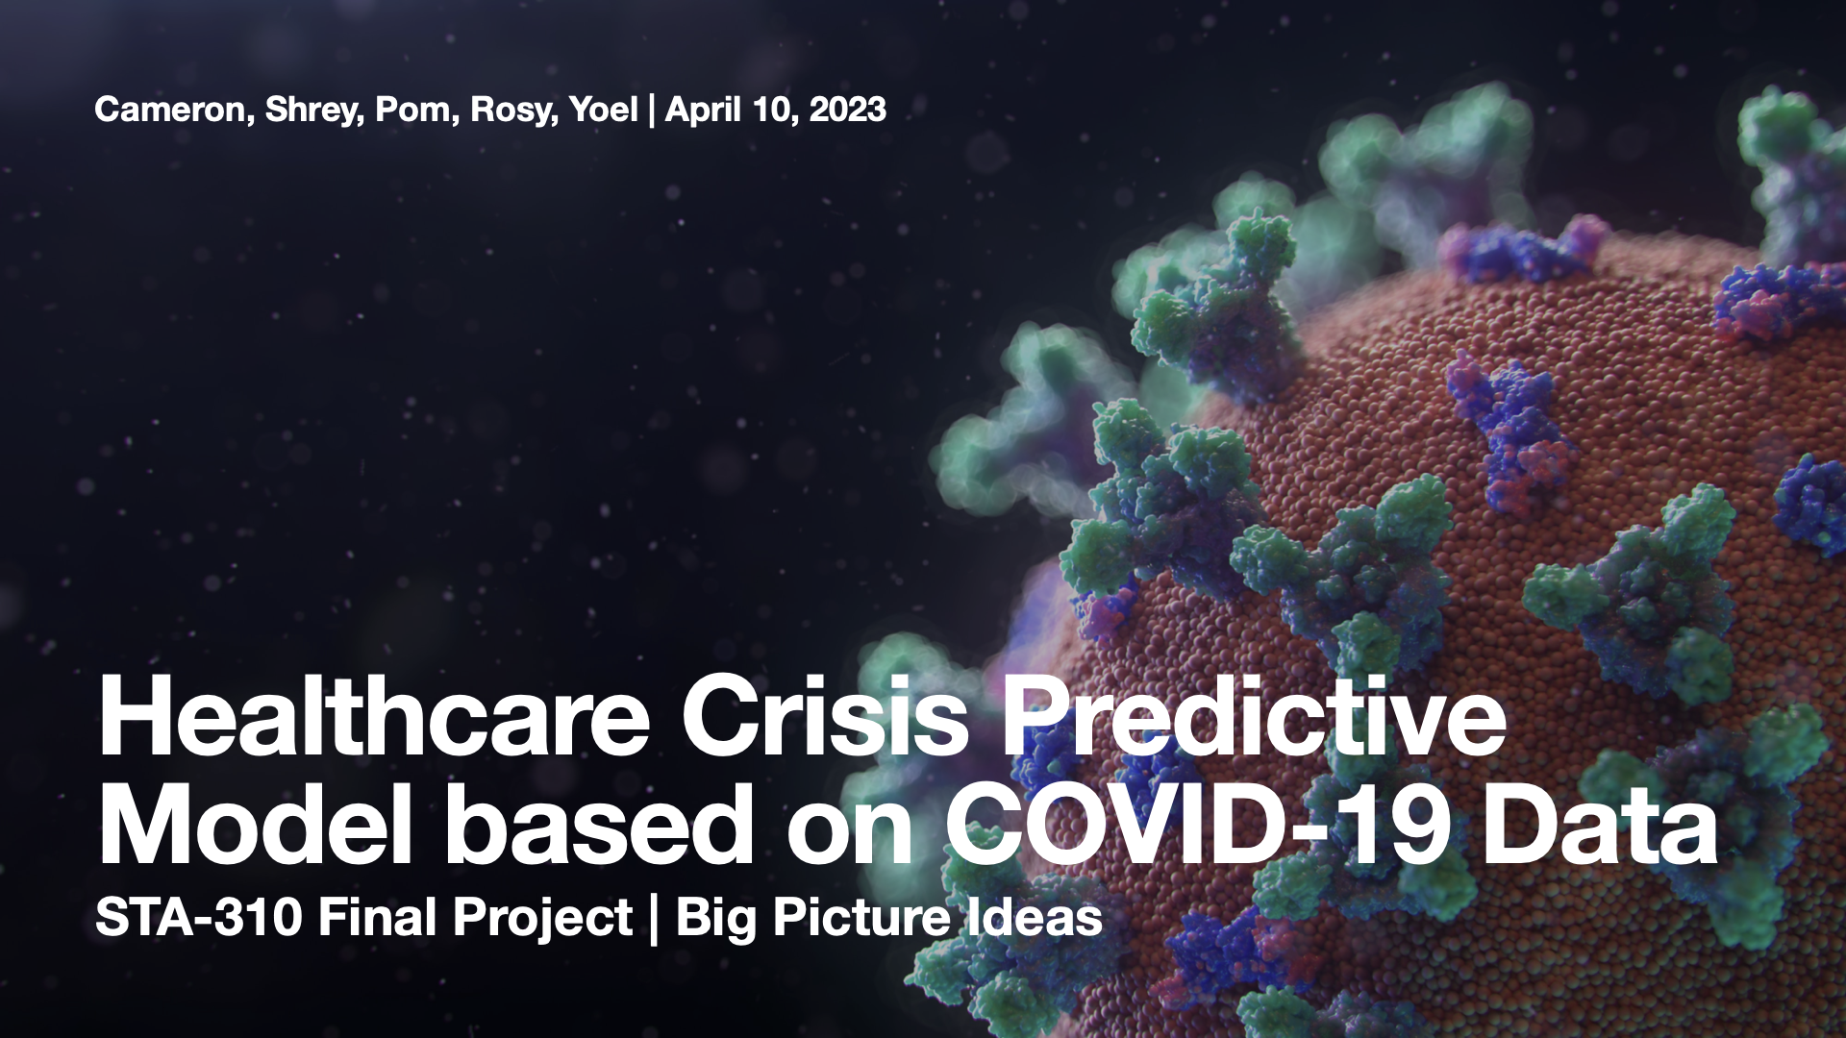

Slide 2
Core Research Question
What are the key variables that predict the COVID-19 mortality rate?
Response variables: Case Fatality Ratio (CFR)
Explanatory variables:
COVID-19 variables: hospital capacity and patient impact
Demographics variables: Total population, race, housing units...
Economic variables: Public transportation, Unemployment rate, Median household income, Health insurance coverage...
Health-related variables: CASTHMA (% of asthma), CHD (Coronary heart disease), COPD (Chronic obstructive pulmonary disease), OBESITY, BINGE (Binge drinking), CSMOKING (Current smoking), SLEEP (Sleeping less than 7 hrs)

Slide 3
Data Sources
Centers for Disease Control and Prevention (CDC)
Cases/deaths & Vaccination
Patient impact and hospital capacity
Chronic diseases & medical history (PLACES Project)
United States Census Bureau
Economic characteristics & Demographics and housing estimate: Annual survey of about 3.5 million households in the United States
Variable types
“is_metro_micro” (i.e., whether the hospital is in a urban or rural area) is treated as categorical variable
All other variables were quantitative variables

Slide 4
Potential Bias & Ethics
Potential bias
The CFR was dynamic during the course of pandemic (early/middle/late stages of the pandemic)
The reason for deaths caused by pandemic may not be the virus but the lack of knowledge or testing availability
People may also die from pre-existing illnesses as they obeyed stay-at-home orders and were concerned about going to a hospital
Pandemic may also lead to a decline in deaths from other causes (i.e., vehicular crashes, etc.)
And many more…like weather, etc.
Ethical concerns
Both CDC and the United States Census Bureau has ensured participants’ privacy during their surveys. (ASA statement)

Slide 5
Previous Studies
COVID-19 has disproportionately affected communities of color in the US
Blacks and Latinos were 4-9 times more likely to be infected than whites
Financial or communal limitations were the major obstacles for the minority communities to access effective public health messaging
Chronic conditions that increase COVID-19 risk disproportionately affect minority populations (both infection and fatality rates)
Betancourt, Joseph R.. "Communities of color devastated by COVID-19: Shifting the narrative - Harvard Health" Health, 22 Oct. 2020, https://www.health.harvard.edu/blog/communities-of-color-devastated-by-covid-19-shifting-the-narrative-2020102221201. Accessed 1 Jan. 1970.

Slide 6
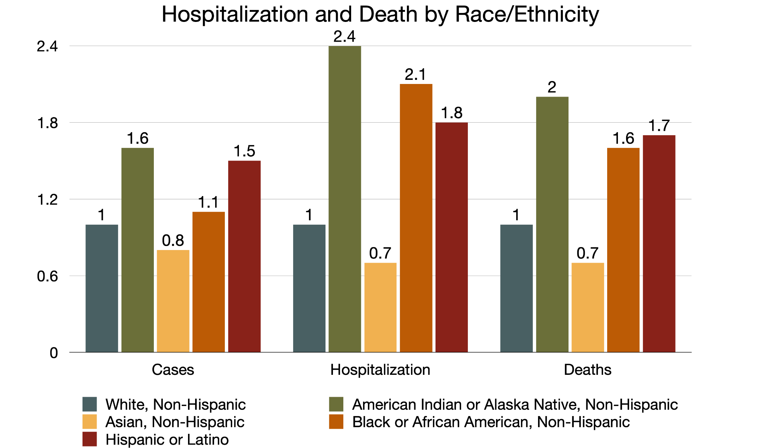
"Risk for COVID-19 Infection, Hospitalization, and Death By Race/Ethnicity | CDC" Cdc, 7 Apr. 2023, https://www.cdc.gov/coronavirus/2019-ncov/covid-data/investigations-discovery/hospitalization-death-by-race-ethnicity.html. Accessed 1 Jan. 1970.

Slide 7
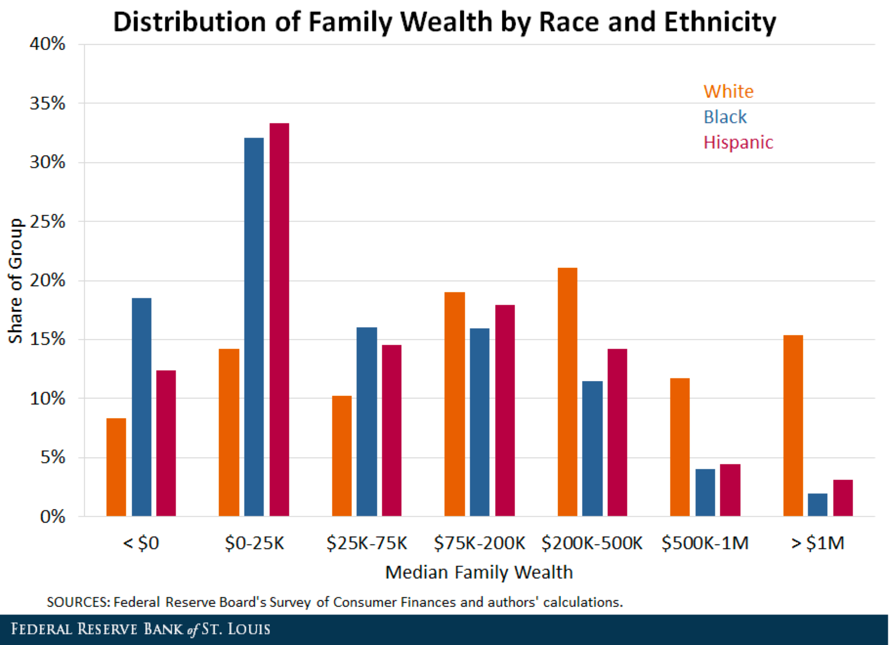
Kent, Ana H., et al. ""Wealth Gaps between White, Black and Hispanic Families in 2019| St. Louis Fed" Stlouisfed, 5 Jan. 2021, https://www.stlouisfed.org/on-the-economy/2021/january/wealth-gaps-white-black-hispanic-families-2019. Accessed 1 Jan. 1970.

Slide 8
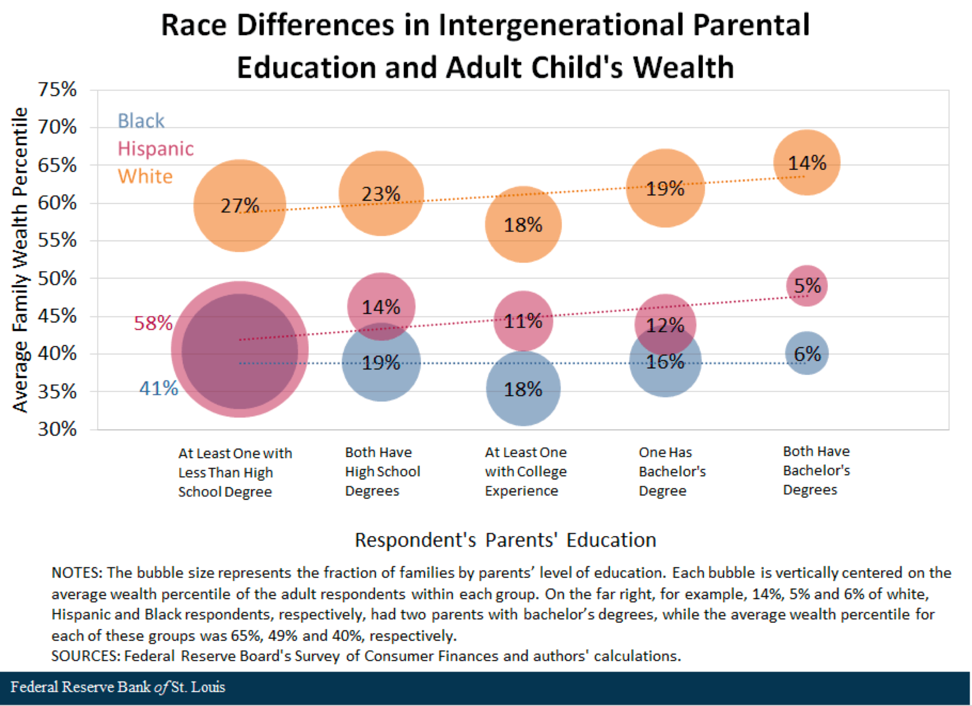
Kent, Ana H., et al. ""Wealth Gaps between White, Black and Hispanic Families in 2019| St. Louis Fed" Stlouisfed, 5 Jan. 2021, https://www.stlouisfed.org/on-the-economy/2021/january/wealth-gaps-white-black-hispanic-families-2019. Accessed 1 Jan. 1970.

Slide 9
Data Cleaning
Merge columns corresponding to fips code
COVID-19 Cases/Deaths: Counts for unknown counties and death cases were shown as N/A
Patient impact & hospital capacity: Average values calculated by < 4 cases were shown as -999,999.0. We will convert this to 0s?
PLACES data: Missing data for all counties in NJ
Economics Characteristics Data: Several columns only contains N/A values
Merge rows by week/month periods
Across most of the datasets: Different collection dates for different datasets within a collection week

Slide 10
Model Analysis
Prior to analysis
Check model assumptions
i.e. multicollinearity, homoscedasticity, equal variance, etc.
Multiple linear regression model
Best subsets methods for a reduced model
Check residual plots, apply transformation if necessary
Conduct extra SS test to compare full model vs. reduced model
Predicted model: COVID-19 Case Fatality Ratio (CFR) = b(0) + Σ(b(i)*X(i,j))
Notes:
For model analysis, we will first check for model assumptions such as multicollinearity, equal variance, and for outliers, then use a best subsets methods to come up with a reduced model that include variables that are significant for predicting mortality rate. Then we will check residual plots, and apply transformations if necessary, then finally conduct an extra sum of squares test to compare the full model and the reduced model.
especially bc we have a lot of numeric data, we should spend a good amount of time checking for mulicolinearity, homoscedasticity, equal variance, etc., then we will perform best subsets methods to come up with a reduced model, then check for residual plots and perform transformations if necessary. b/c our purpose of creating a multiple linear regression model is not to have a high r-squared value and have precise predictions, but we want to sort out significant variables in predicting case fatality ratio, we are planning to really focus on residual plots

Slide 11
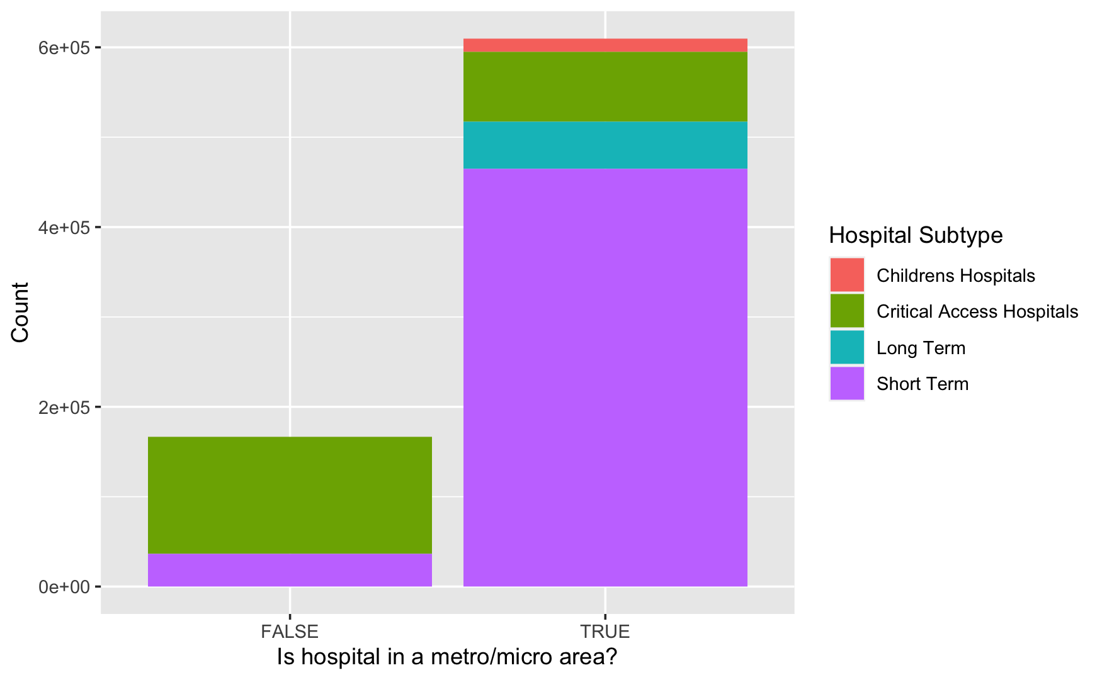
Hospital dataset

Slide 12
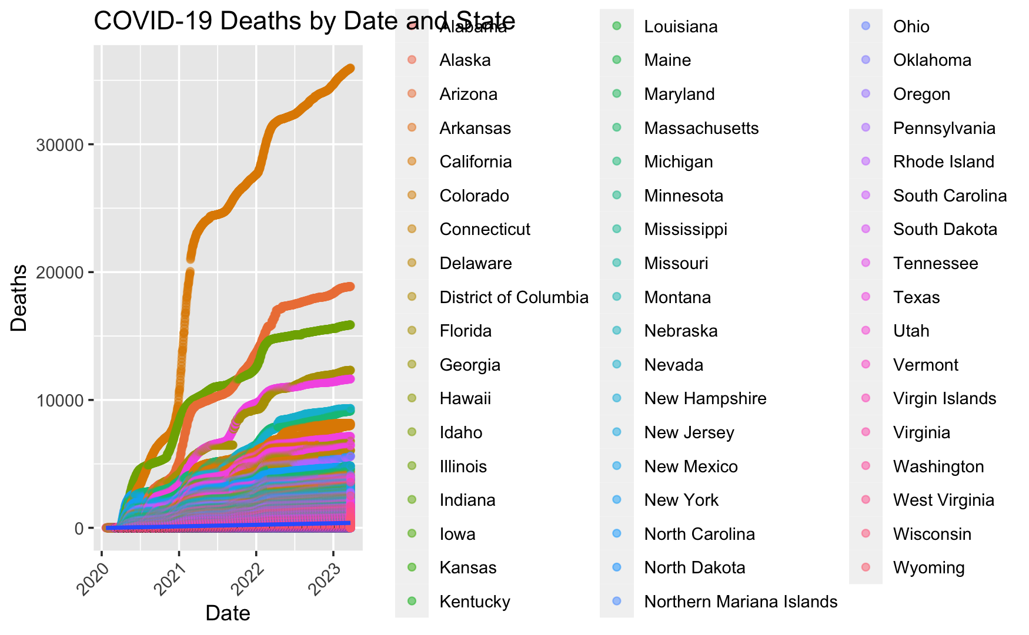
Covid-cases-deaths dataset

Slide 13
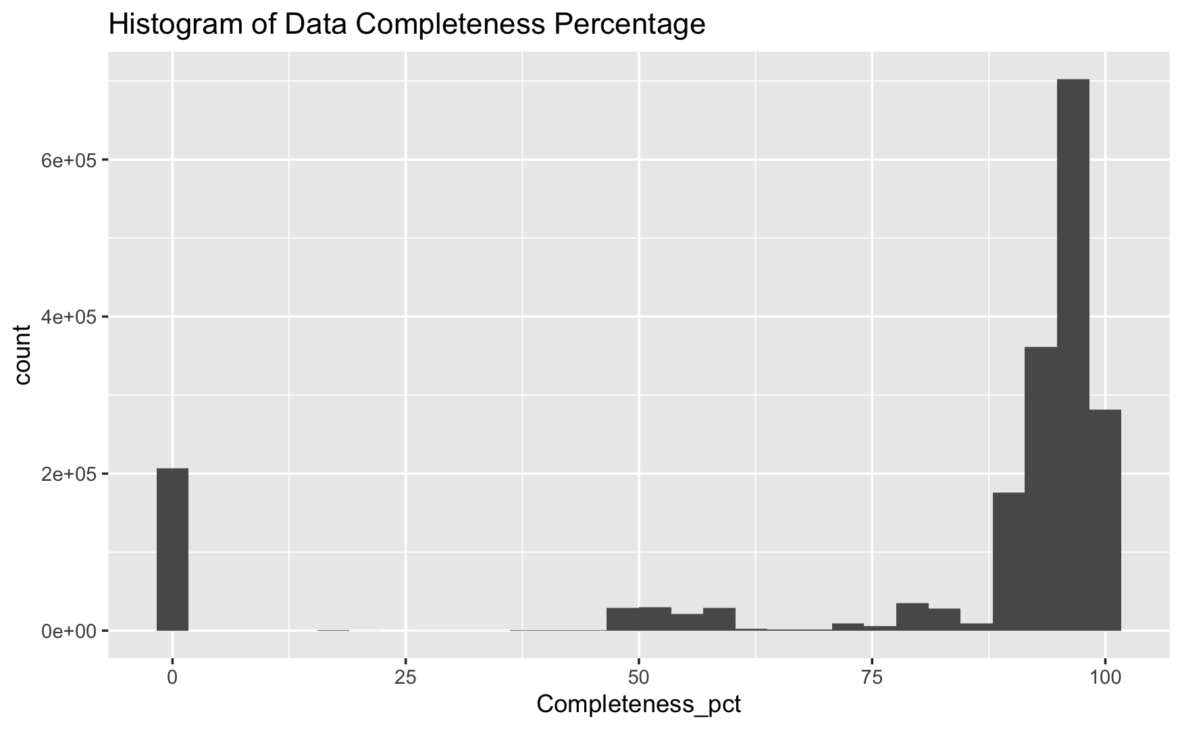
Vaccination dataset

Slide 14
Additional Research Questions
Will holidays and weekends impact a community’s medical capacity when facing serious pandemic such as COVID-19?
Would relevant/selected variables change depending on variants that were dominant in certain time frames?
How do political factors influence mortality rate?
Red vs Blue States

Slide 15
Works Cited
Betancourt, Joseph R.. "Communities of color devastated by COVID-19: Shifting the narrative - Harvard Health" Health, 22 Oct. 2020, https://www.health.harvard.edu/blog/communities-of-color-devastated-by-covid-19-shifting-the-narrative-2020102221201. Accessed 1 Jan. 1970.
"Risk for COVID-19 Infection, Hospitalization, and Death By Race/Ethnicity | CDC" Cdc, 7 Apr. 2023, https://www.cdc.gov/coronavirus/2019-ncov/covid-data/investigations-discovery/hospitalization-death-by-race-ethnicity.html. Accessed 1 Jan. 1970.
Kent, Ana H., et al. ""Wealth Gaps between White, Black and Hispanic Families in 2019| St. Louis Fed" Stlouisfed, 5 Jan. 2021, https://www.stlouisfed.org/on-the-economy/2021/january/wealth-gaps-white-black-hispanic-families-2019. Accessed 1 Jan. 1970.

